Slide 1
Introduction to EEG Processing Part II
Sarah Sheldon

Slide 2
Matlab Code on Github: https://github.com/ssheldo/EEG_process_talk
Practice_EEG_Analysis.m demonstrates principles using functions created for processing and analysis (functions found in Kyle_EEG_analysis folder)
outline.m has signal processing examples and demonstrations of principles

Slide 3
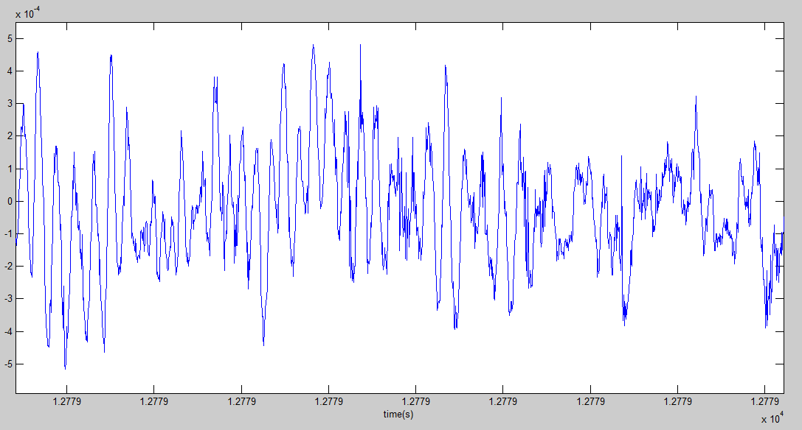
How do we describe time varying signals?
Convert to frequency domain
Wavelet decomposition
Wigner distribution
Fourier transform
Notes:
What does stationary mean – statistics are invariant over time.
- how do we analyze it?

Slide 4
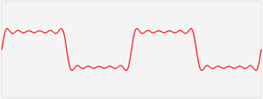
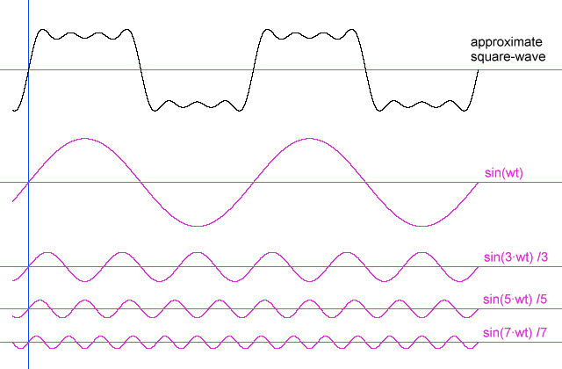
Time-Frequency Analysis
We model our signal as a linear combination of sine waves

Slide 5
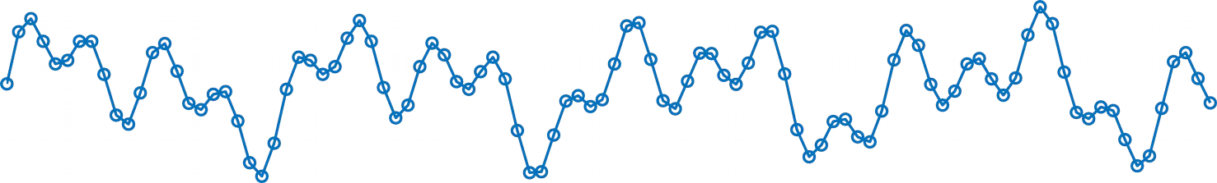
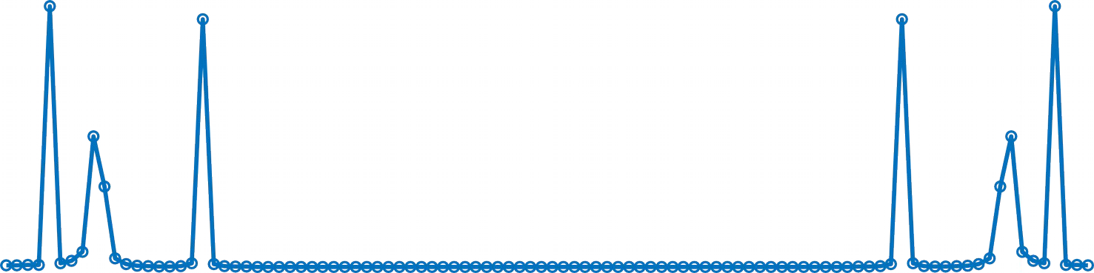
(De) Composing a signal
0 sec
Time
1 sec
Peaks in frequency domain (left) correspond to an oscillatory component in time domain (above)
Power
0 Hz
Frequency
50 Hz

Slide 6
(De) Composing a signal
0 sec
Time
1 sec
Peaks in frequency domain (left) correspond to an oscillatory component in time domain (above)
Power
0 Hz
Frequency
50 Hz

Slide 7
(De) Composing a signal
0 sec
Time
1 sec
Peaks in frequency domain (left) correspond to an oscillatory component in time domain (above)
Power
0 Hz
Frequency
50 Hz

Slide 8
(De) Composing a signal
0 sec
Time
1 sec
Peaks in frequency domain (left) correspond to an oscillatory component in time domain (above)
Power
0 Hz
Frequency
50 Hz

Slide 9
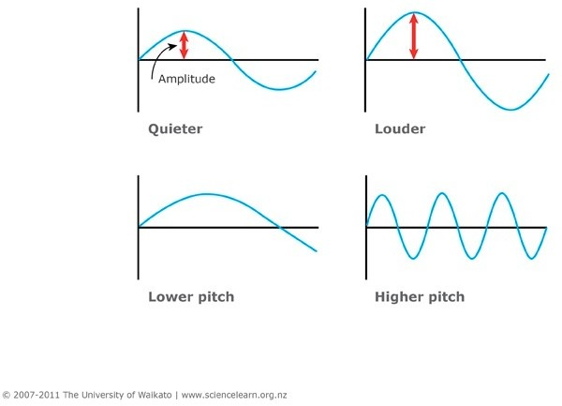
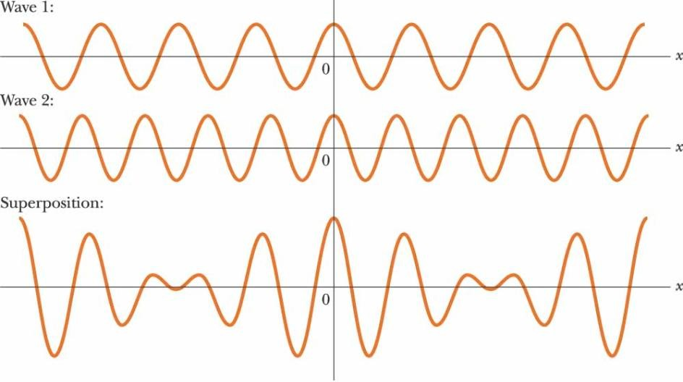
Think of music…
Phase
Amplitude
Frequency

Slide 10
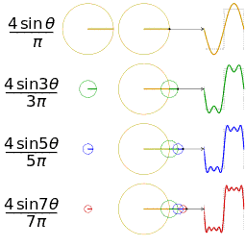
Time domain signal and its frequency spectrum
First 4 Fourier components for the square wave function:
Amplitude: how big is circle
Phase: offset in position on circle
wikipedia

Slide 11
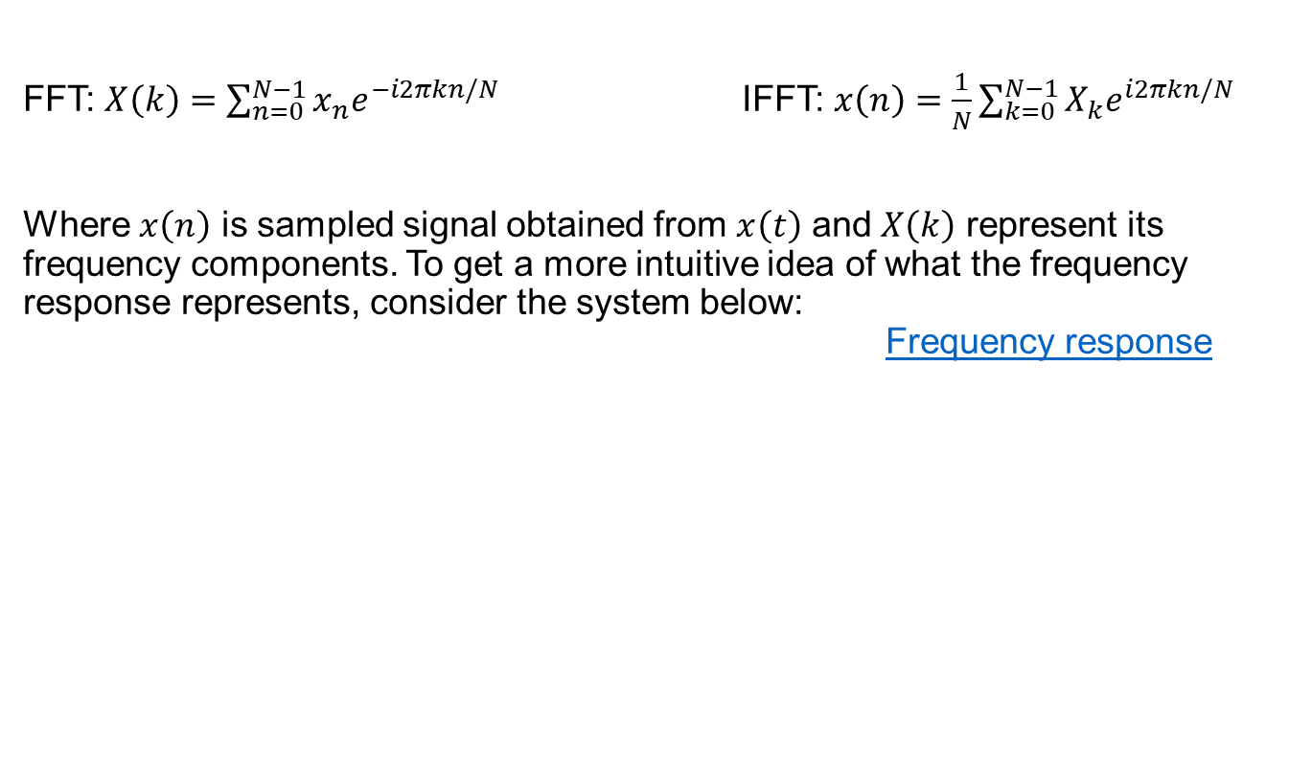
Good Interactive Introductions to FFT:
http://www.jezzamon.com/fourier/index.html
https://betterexplained.com/articles/an-interactive-guide-to-the-fourier-transform/
FFT: $X\left(k\right)=\sum_{n=0}^{N−1}{x_{n}e^{−i2πkn/N}}$ IFFT: $x\left(n\right)=\frac{1}{N}\sum_{k=0}^{N−1}{X_{k}e^{i2πkn/N}}$
Where $x\left(n\right)$ is sampled signal obtained from $x\left(t\right)$ and $X\left(k\right)$ represent its frequency components. To get a more intuitive idea of what the frequency response represents, consider the system below: Frequency response

Slide 12
Fourier Analysis
Time Domain
Frequency Domain
Fourier Transform
Amplitude (or Power)
Inverse Fourier Transform
(Phase, too!)
Any waveform is equivalent to the sum of a set of sine waves of different frequencies, amplitudes and phases
Time domain: Amplitude as a function of time
Frequency domain: Amplitude and phase as a function of frequency
Fourier transform converts time domain to frequency domain
Inverse Fourier transform converts frequency domain to time domain
Notes:
© S. J. Luck. All Rights Reserved. May be used for nonprofit educational purposes if this copyright notice is included. Permission must be obtained from the copyright holder(s) for any other use.

Slide 13
Fourier Analysis
Square wave at F Hz
Amplitude
Time
Fourier transform of square wave at F Hz
Amplitude
+ 9F + 11F + 13F …
Frequency

Slide 14
Phase and the “Imaginary” Component
If you add a sine wave and a cosine wave of the same frequency, you get a sinusoid of the same frequency but a different amplitude and phase
Two different ways to characterize a sinusoid of a given frequency:
Phase and Amplitude
Sine Component and Cosine Component
Amplitude = sqrt(sine² + cosine²)
Phase = arctan(cosine/sine)

Slide 15
Phase and the “Imaginary” Component
If you add a sine wave and a cosine wave of the same frequency, you get a sinusoid of the same frequency but a different amplitude and phase
Two different ways to characterize a sinusoid of a given frequency:
Phase and Amplitude
Sine Component and Cosine Component
Amplitude = sqrt(sine² + cosine²)
Phase = arctan(cosine/sine)

Slide 16
Time domain signal and its frequency spectrum
Y = fft(X,n) returns the n-point DFT.
fft(X) is equivalent to fft(X, n) where n is the size of X in the first non-singleton dimension. If the length of X is less than n, X is padded with trailing zeros to length n. If the length of X is greater than n, the sequence X is truncated. When X is a matrix, the length of the columns are adjusted in the same manner.
y = ifft(X,n) returns the n-point inverse DFT of vector X.
FFT: $X\left(k\right)=\sum_{n=0}^{N−1}{x_{n}e^{−i2πkn/N}}$ IFFT: $x\left(n\right)=\frac{1}{N}\sum_{k=0}^{N−1}{X_{k}e^{i2πkn/N}}$
Where $x\left(n\right)$ is sampled signal obtained from $x\left(t\right)$ and $X\left(k\right)$ represent its frequency components. To get a more intuitive idea of what the frequency response represents, consider the system below: Frequency response

Slide 17
How do we describe time varying signals?
Convert to frequency domain
Wavelet decomposition
Wigner distribution
Fourier transform
Notes:
What does stationary mean – statistics are invariant over time.
- how do we analyze it?

Slide 18
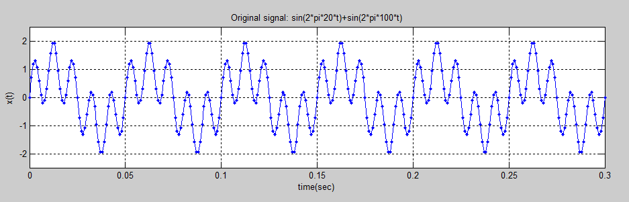
FFT and IFFT examples
F1=20;
F2=100;
Fs = 1000; % Sampling frequency
Ts = 1/Fs; % Sampling time
t=0:Ts:.3;
x=sin(2*pi*F1*t)+sin(2*pi*F2*t);
L=numel(x);
Notes:
First, lets make a signal that is the sum of two sinusoids

Slide 19
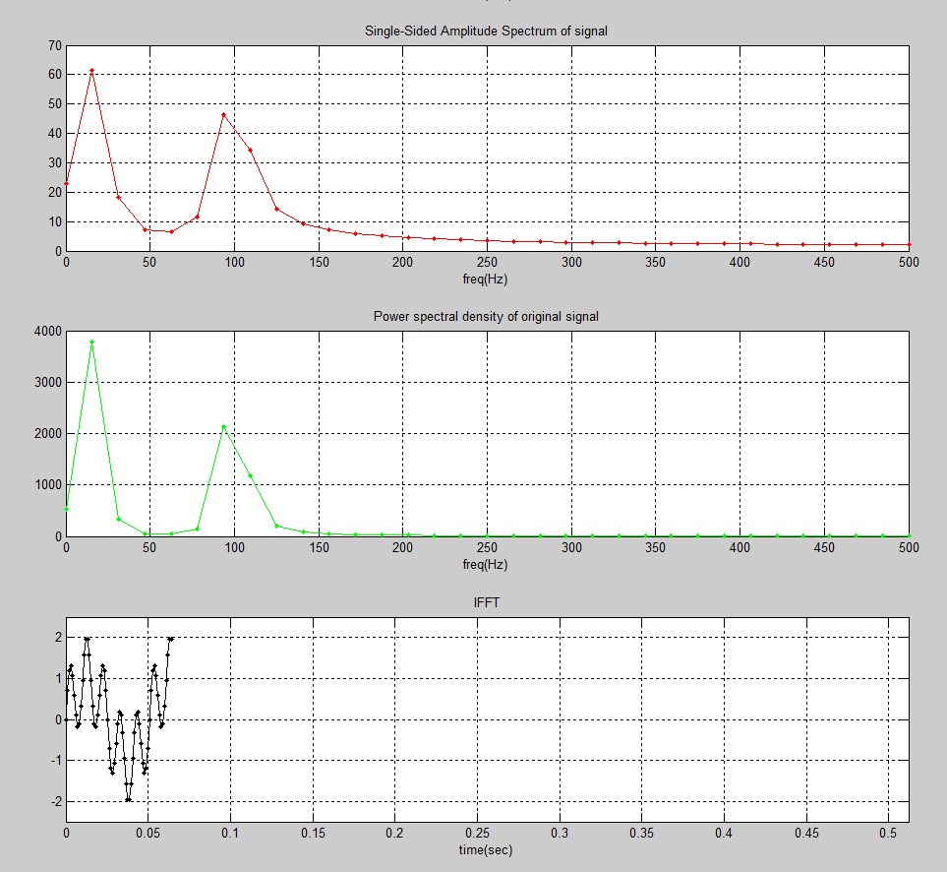
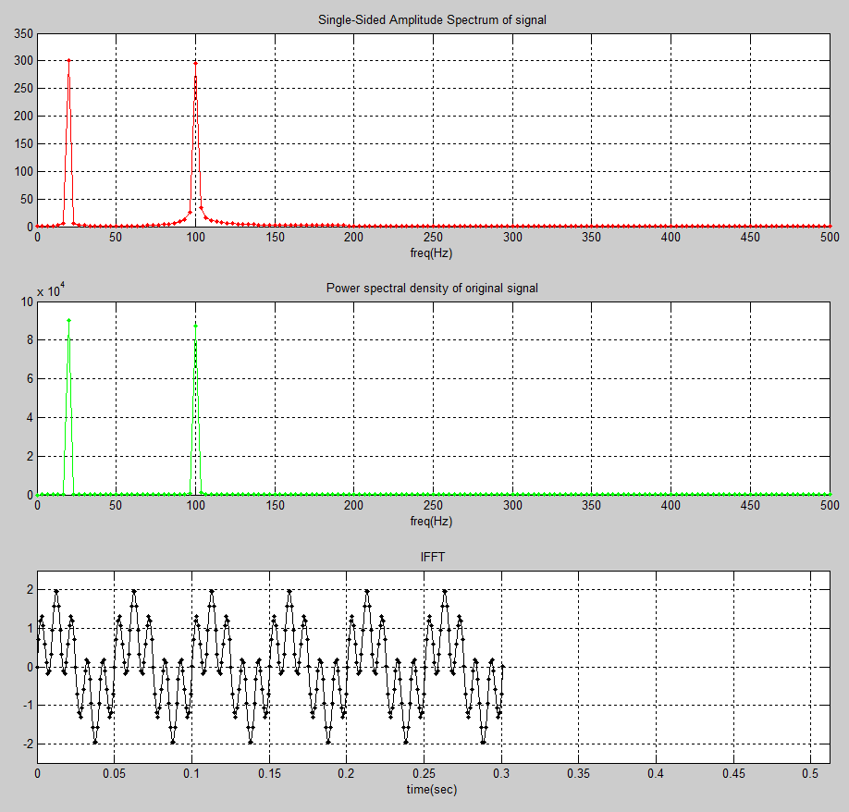
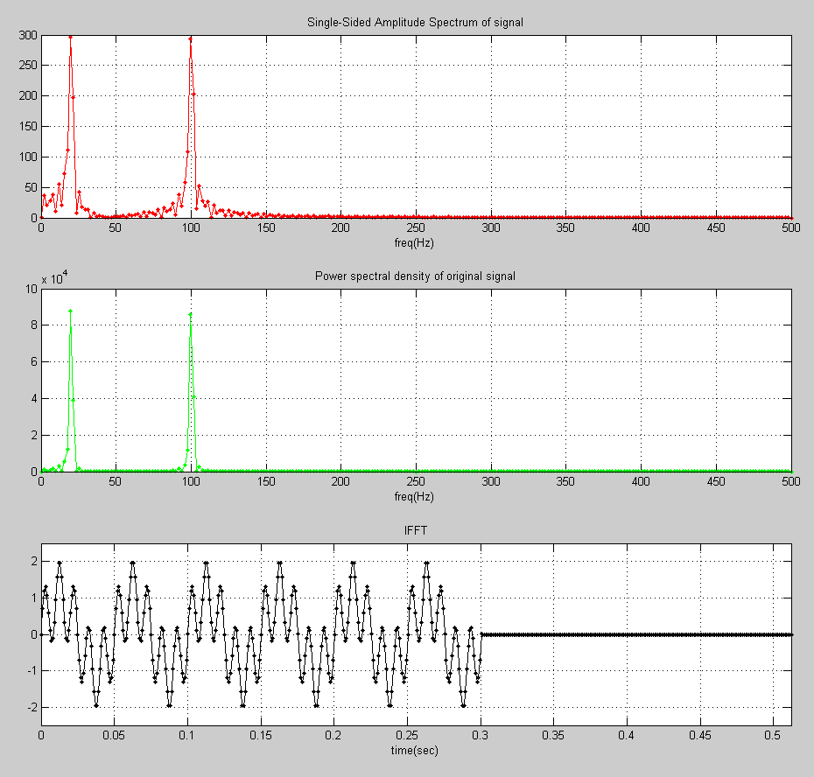
FFT and IFFT examples
L=301 number of samples.
64-point fft 301-point fft 512-point fft
(Truncated) (N=L) (Zero padded)
Higher variance in FFT peaks
Sharp FFT peaks
FFT is ‘noisy’
Partial reconstruction in t
Full reconstruction in t
iFFT has zeros

Slide 20
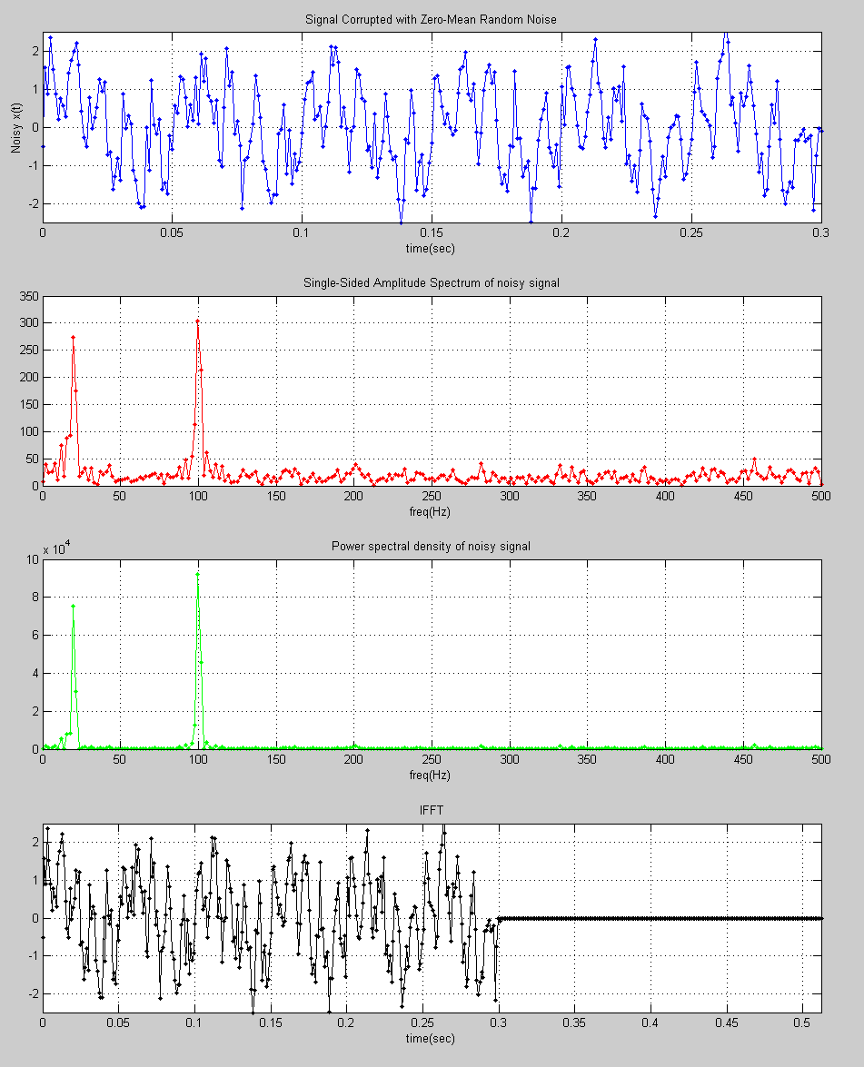
FFT and IFFT examples
F1=20;
F2=100;
Fs = 1000; % Sampling frequency
Ts = 1/Fs; % Sampling time
t=0:Ts:.3;
x=sin(2*pi*F1*t)+sin(2*pi*F2*t);
NFFT = pow2(nextpow2(L));
% Signal plus Zero-Mean Random Noise
noisy_x = x+.5*randn(1,nemel(x));
plot(t,noisy_x,'.-');
fft_noisy_x = fft(noisy_x,NFFT);
plot(f,2*abs(fft_noisy_x(1:NFFT/2+1)),'r.-')
plot(f,4*p2(1:NFFT/2+1),'g.-')
plot((0:1/(NFFT-1):1)*NFFT*Ts,real(ifft_noisy_x),'k.-')

Slide 21
FFT and IFFT examples
Try: ex2_FFT_IFFT.m
Step through it
Plot fft_x, why does it look like that?
Plot the amplitude spectrum using abs()
It is symmetric; so just use the 1st half:
Try: ex2_FFT_IFFTPractice.m
Number samples/sec > nyquist?
Number samples/sec < nyquist?
Number FFT < number samples?
Number of iFFT < number FFT?

Slide 22
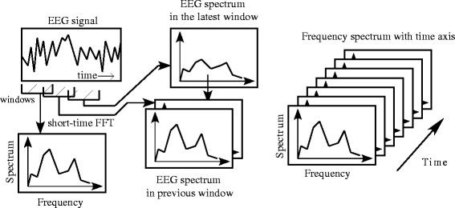
Problem with FFT

Slide 23
Thank You!
Email me if you have any questions: ssheldon@ualberta.ca

Slide 24
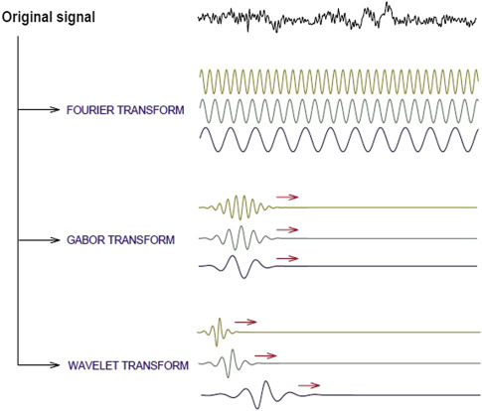

Slide 25
Fundamental Principle #1
Power at a frequency in a Fourier transform does not mean that an oscillation was present at that frequency
What the #$%$#&@?!!!
Then what does power at a frequency mean?
Power at a frequency means that a sine wave at that frequency, when added to other sine waves at other frequencies, can create an equivalent waveform
It does not mean that the biological signal consists of the sum of these sine waves

Slide 26


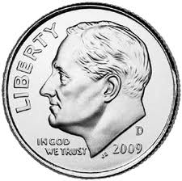
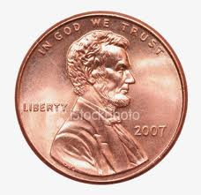
Analogy: Money
A $1 bill is equal in value to 4 quarters
It is not made of 4 quarters!
It can be exchanged for 4 quarters
It can also be exchanged for 9 dimes + 10 pennies

Slide 27
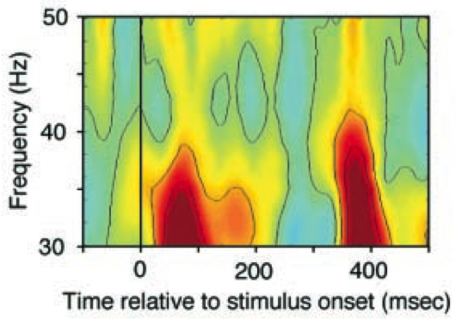
Time-Frequency Analysis
Each slice is the application of one Gabor function at the specified frequency, with amplitude coded by color
The family of Gabor functions is a Morlet wavelet
Csibra et al. (2000, Science)

Slide 28

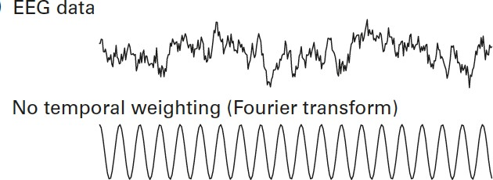
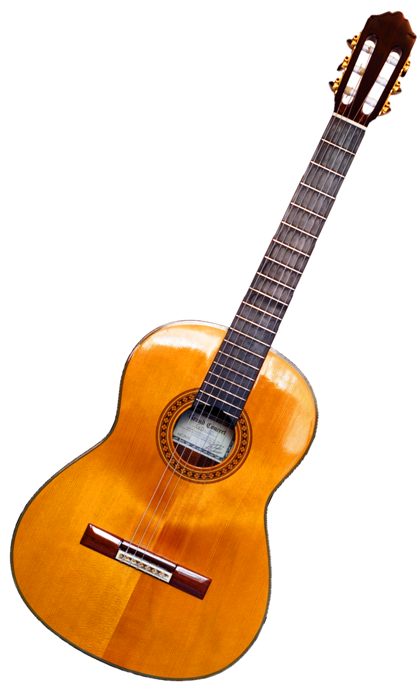
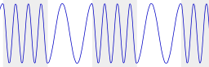

What’s the problem with that?
Frequency changes over time

Slide 29
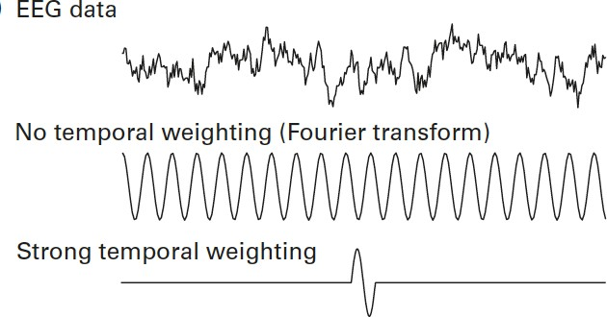
What would we want?
 Something that includes a temporal weighting

Slide 30

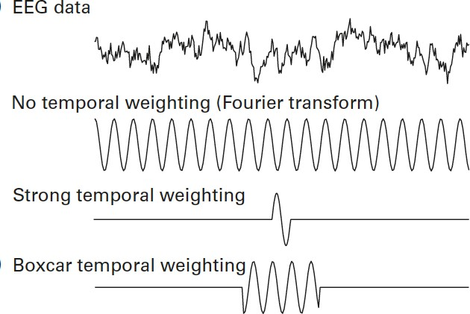
What would we want?
 Something that includes a temporal weighting

Slide 31
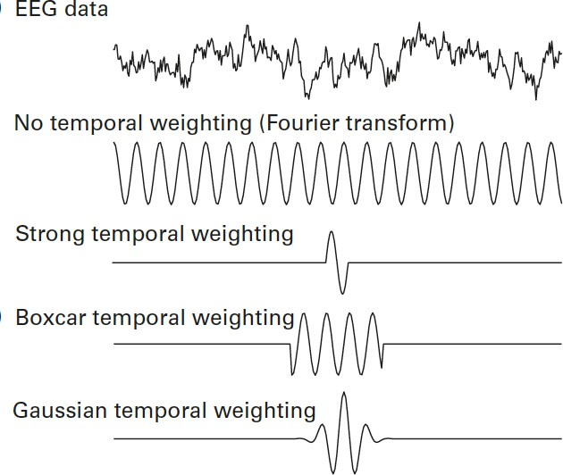
What would we want?
 Something that includes a temporal weighting
Morlet wavelet

Slide 32
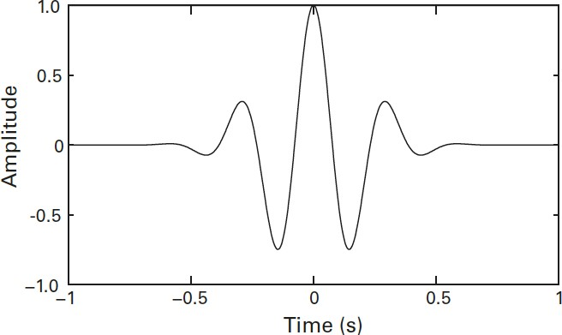
What is this talk about?
Time-frequency representations retain advantages of both time and frequency domain While making only small sacriﬁces to precision:
Frequency information at each point in time is a weighted sum of the frequency information of the instantaneous time AND the neighboring time.

Slide 33
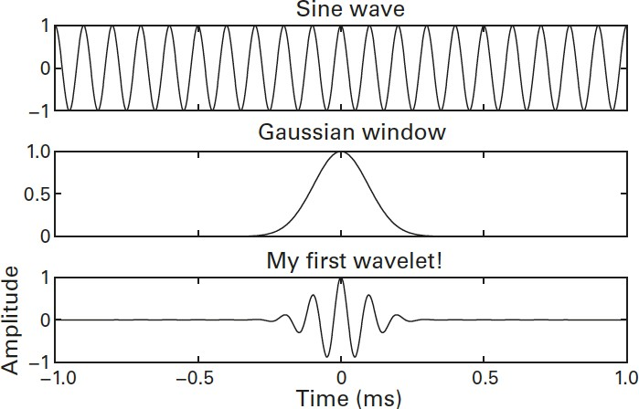






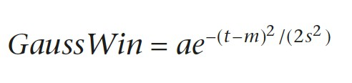

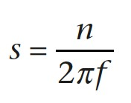





How to make a Morlet wavelet
Instead of using many sine waves with diﬀerent frequencies, time-frequency decomposition uses many wavelets with diﬀerent frequencies.

Slide 34
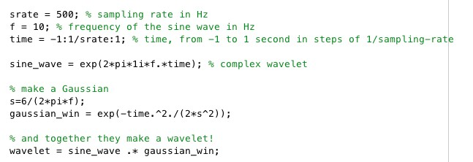
http://moargeek.com/2014/07/29/nerd-nerd-nerd-nerd-word/

Slide 35
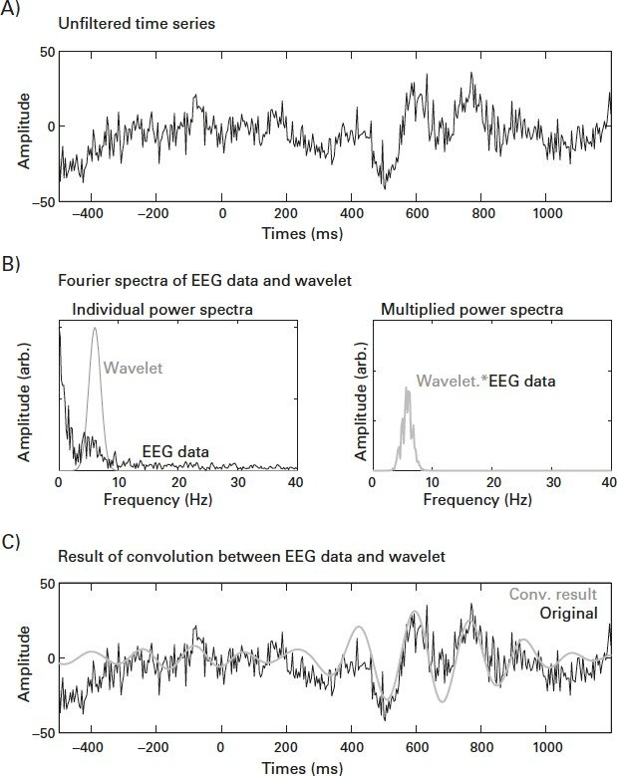
Wavelet Convolution as a Bandpass Filter
Remember a convolution is the time-varying mapping between a kernel (here the wavelet) and a signal (EEG).

Slide 36
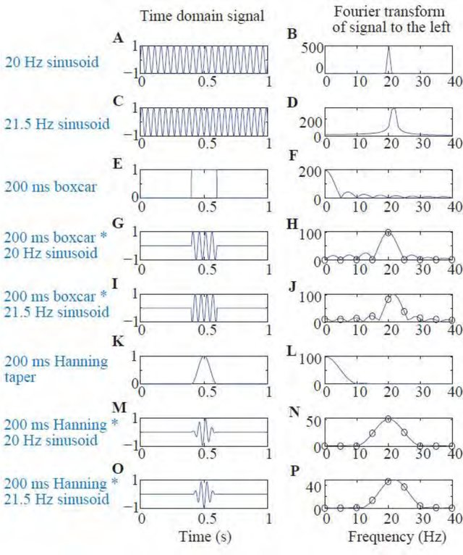

Slide 37
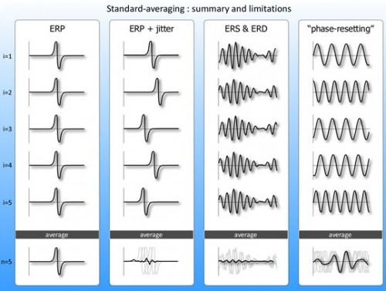

Slide 38
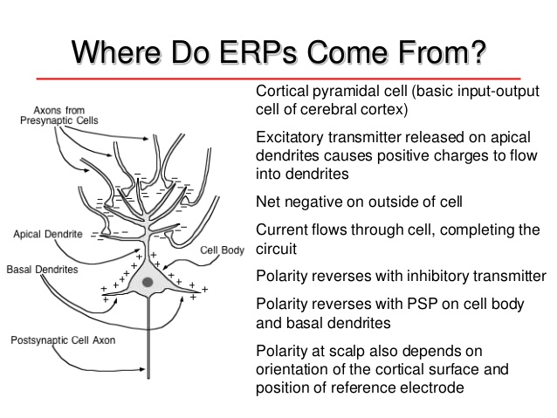
Some Basics of Neuroscience

Slide 39
Some Basics of Neuroscience
Resting membrane potential
-70 mV on inside of cell
Action potentials
Triggered when membrane potential goes sufficiently positive
Starts at axon hillock and travels down axon
Rarely contributes to scalp EEG
Postsynaptic potentials (PSPs)
Neurotransmitter binds with receptor, opens ion channels
Excitatory: Positive charges move into cell
Inhibitory: Negative charges move into cell
The origin of most EEG signals

Slide 40
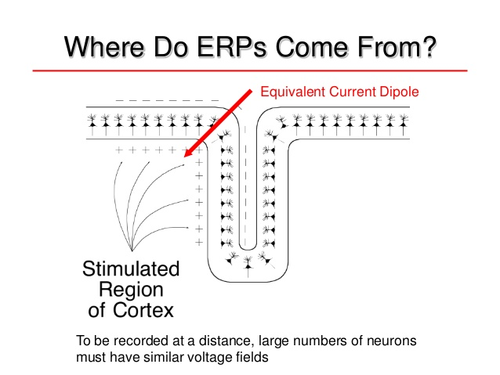
Some Basics of Neuroscience

Slide 41
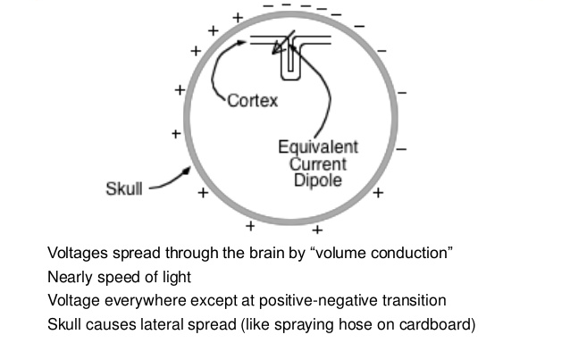
Some Basics of Neuroscience

